Slide 1
Browsers
Your options

Slide 2
Differing Browsers
Different browsers have their pros and cons
Most people have a preferred browser
You need to test your site on multiple browsers.

Slide 3
Internet Explorer
One of the most popular browsers
Preinstalled on Microsoft Windows and free to download
Not available on the Mac

Slide 4
Safari
Works on Mac and Windows operating systems
Free to download
Default browser on iPhones and iPads

Slide 5
Google Chrome
Freeware browser developed by Google
Fast browsing
Greater security

Slide 6
Firefox
Free browser developed by Microsoft
Works on Windows and Mac
Secure and fast
Resource heavy

Slide 7
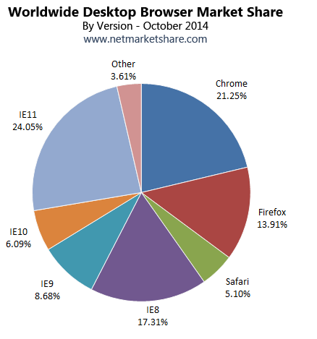

Slide 8
Review
Browsers can vary in how well they adhere to HTML5 standards
Different versions of browsers need to be considered as well

Slide 9

Acknowledgements/Contributions
These slides are Copyright 2015- Colleen van Lent as part of http://www.intro-webdesign.com/ and made available under a Creative Commons Attribution Non Commercial 4.0 License. Please maintain this last slide in all copies of the document to comply with the attribution requirements of the license. If you make a change, feel free to add your name and organization to the list of contributors on this page as you republish the materials.
Initial Development: Colleen van Lent , University of Michigan School of Information

